Slide 1
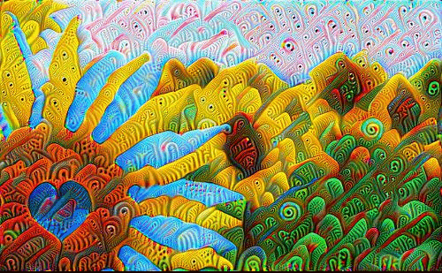
A Painter that Does Not Exist - Generative Image Production with Machines

Slide 2
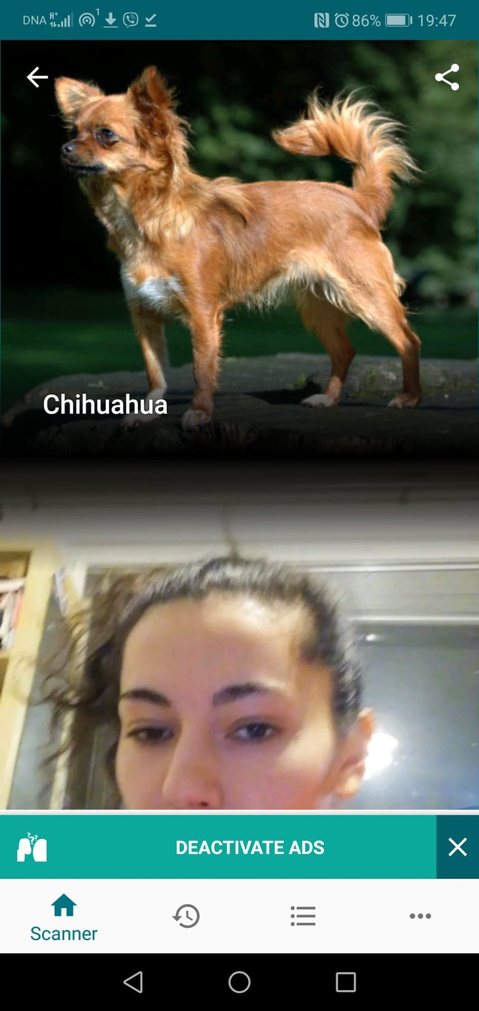
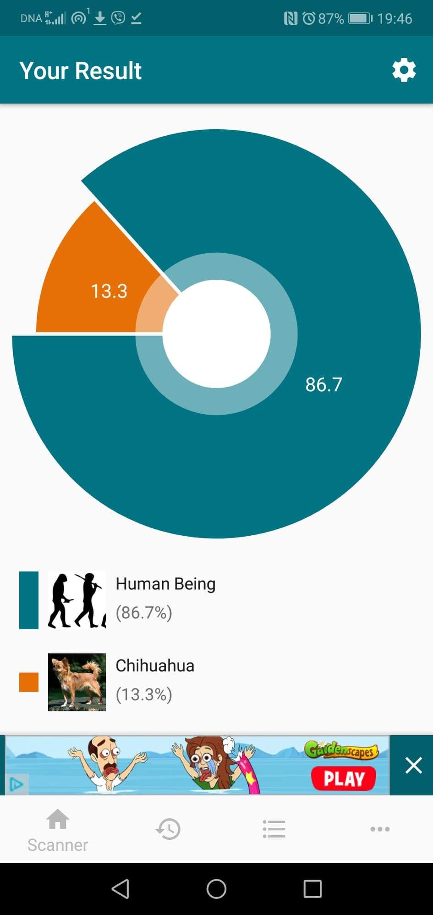
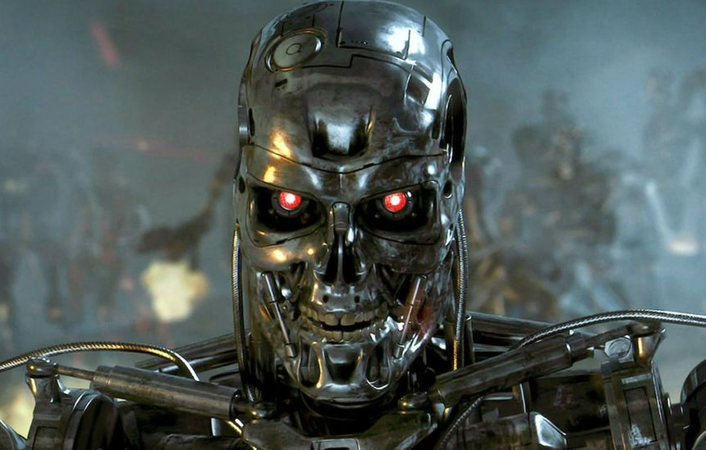
Expectation
AI, machine learning, deep learning, …
Reality

Slide 3
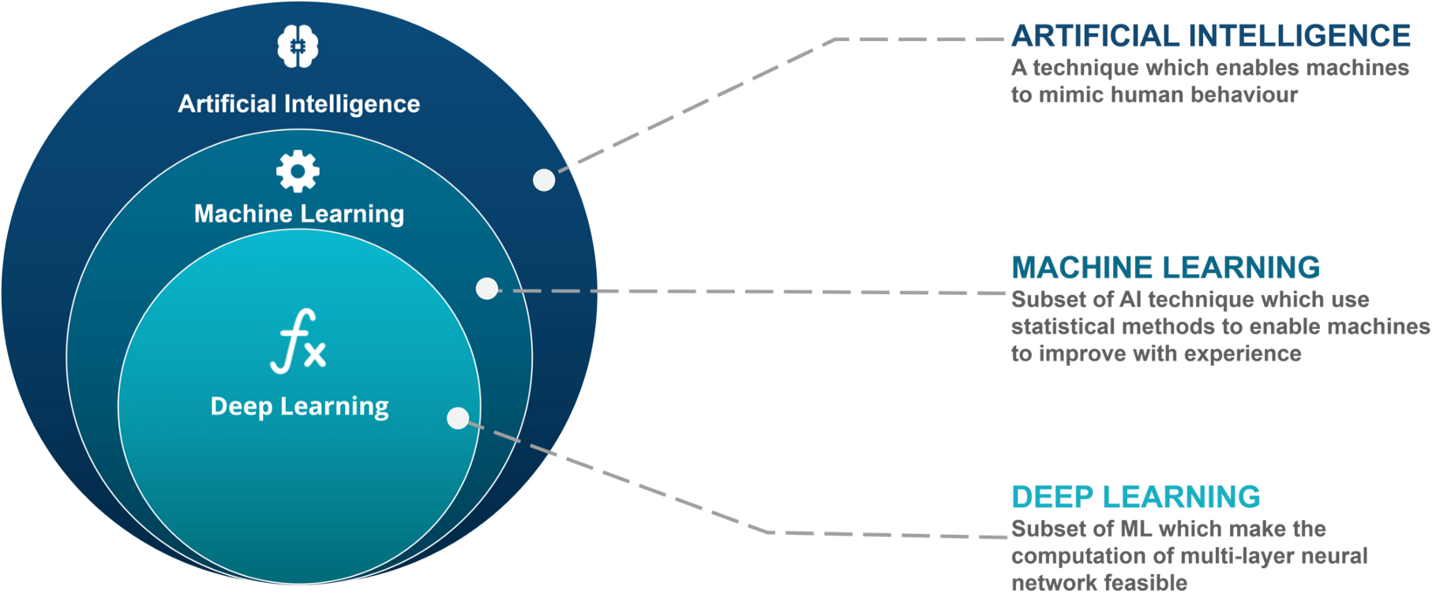

Slide 4
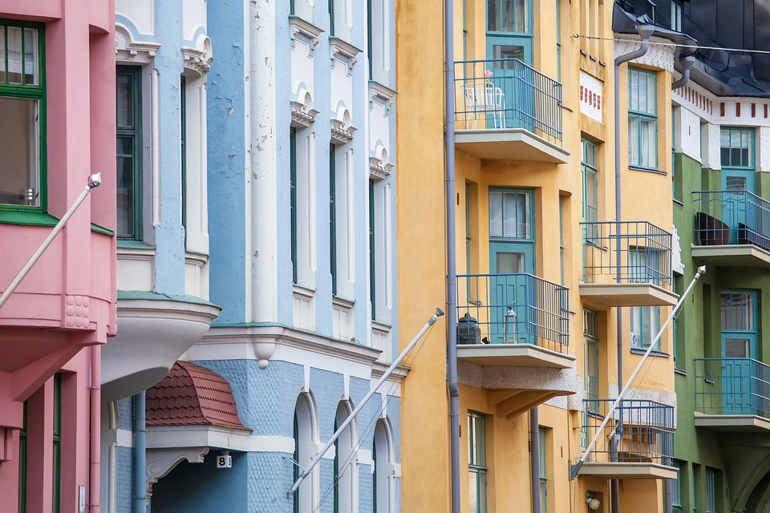
House price prediction
house area,
n.o. rooms/ bathrooms,
neighborhood,
building age,
future rennovations,
etc.

Slide 5
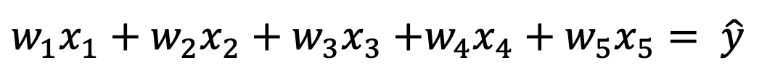
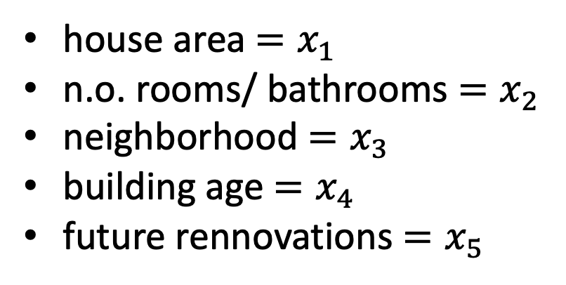
House price prediction
house area$=x_{1}$
n.o. rooms/ bathrooms $=x_{2}$
neighborhood $=x_{3}$
building age $=x_{4}$
future rennovations $=x_{5}$
${w_{1}x}_{1}+{w_{2}x}_{2}+{w_{3}x}_{3}$ $+{w_{4}x}_{4}+{w_{5}x}_{5}= \hat{y}$

Slide 6
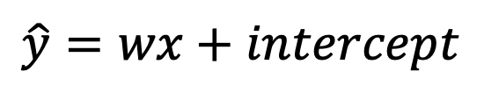
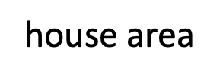
Historical Data
$$\hat{y}=wx+intercept$$
price
house area

Slide 7
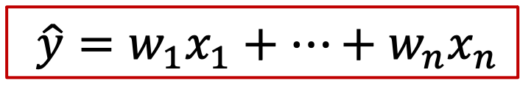
$${{ \hat{y}=w}_{1}x}_{1}+…+{w_{n}x}_{n}$$
house area
x₁
W₁
weighted sum
prediction
W₂
ŷ
x₂
∑
neighborhood
W₃
building age
x₃

Slide 8
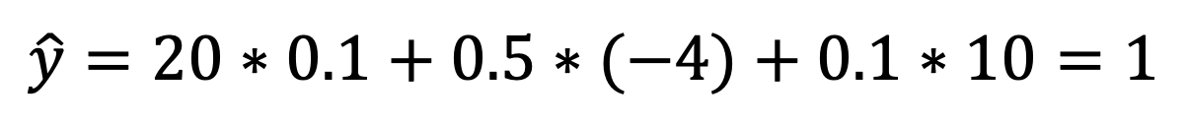
$$\hat{y}=20∗0.1+0.5∗(−4)+0.1∗10=1$$
weighted sum
prediction
x₁=20
W₁= 0.1
W₂ = -4
∑
ŷ
x₂=0.5
W₃ = 10
x₃=0.1

Slide 9
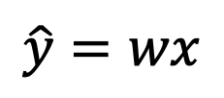
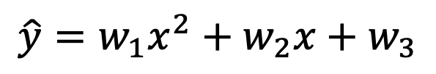
Historical Data
$$\hat{y}=wx$$
price
$$\hat{y}=w_{1}x^{2}+w_{2}x+w_{3}$$
house area

Slide 10
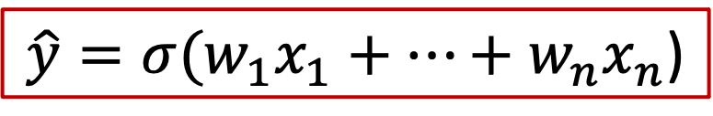
non-linear transformation
$${{\hat{y}=σ(w}_{1}x}_{1}+…+{w_{n}x}_{n}\text{)}$$
x₁
W₁
weighted sum
non-linearity
prediction
W₂
ŷ
x₂
∑
W₃
x₃

Slide 11
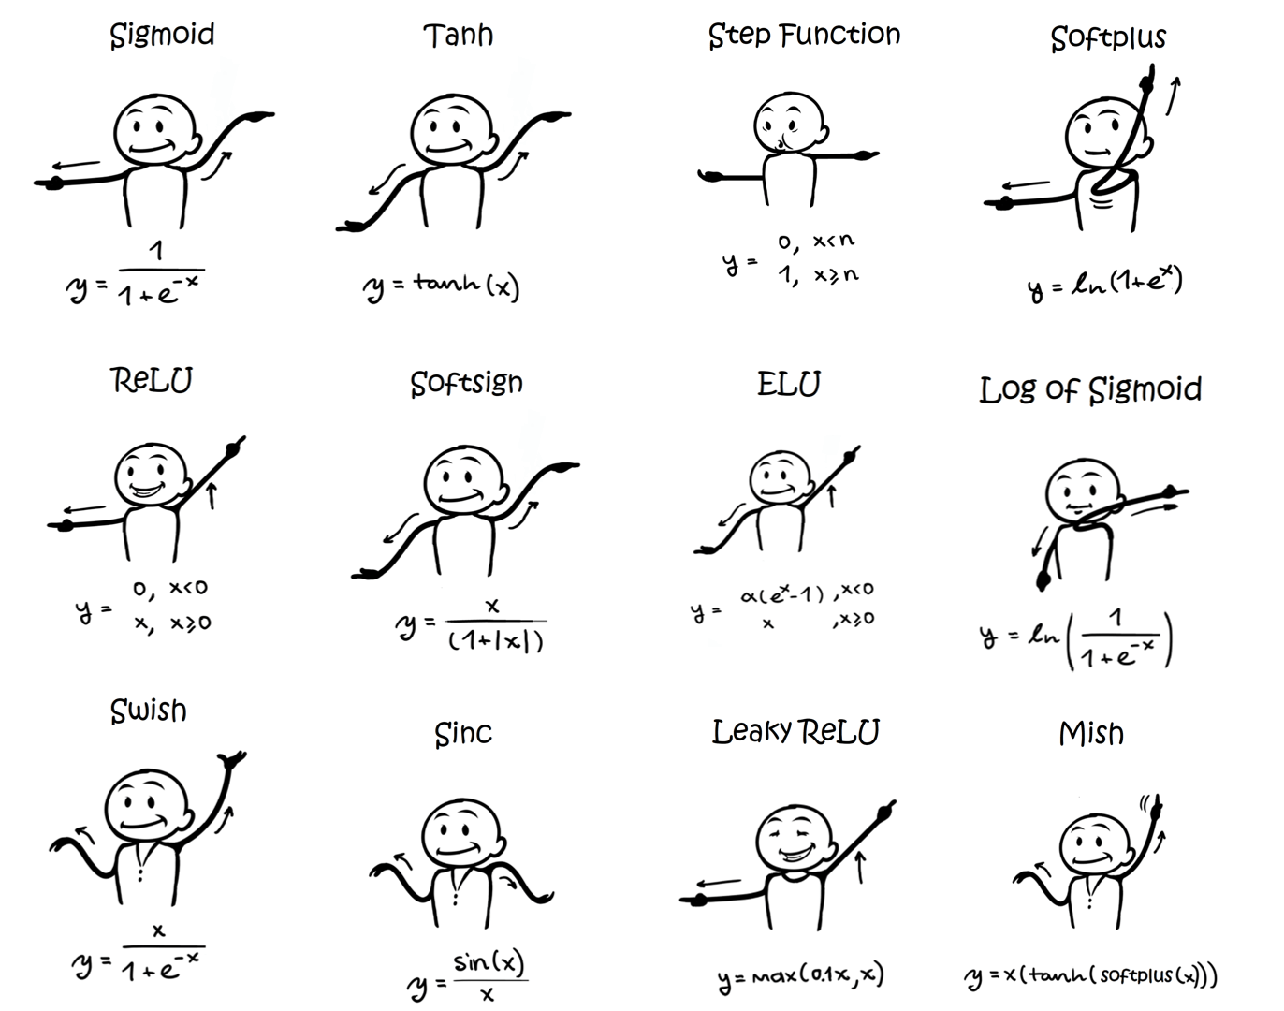

Slide 12


Slide 13
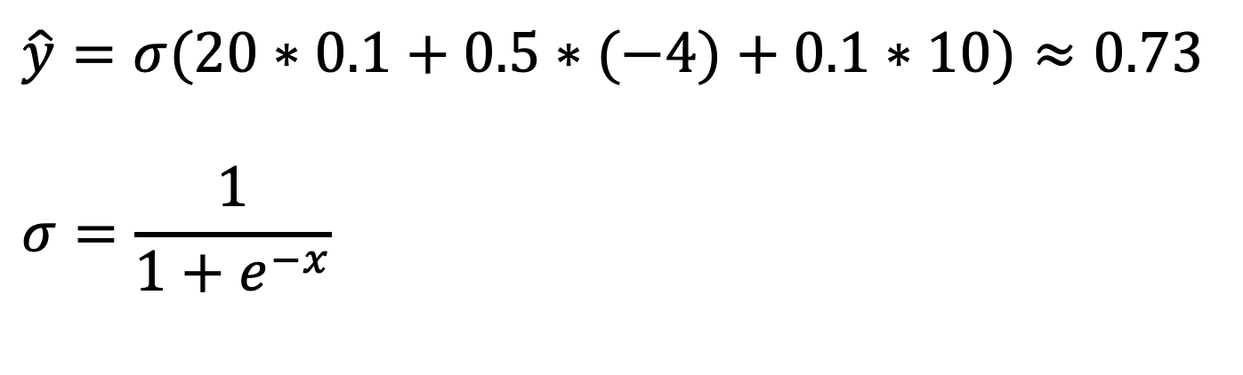
$$\hat{y}=σ(20∗0.1+0.5∗(−4)+0.1∗10)≈0.73$$
$$σ=\frac{1}{1+e^{−x}}$$
weighted sum
non-linearity
prediction
x₁=20
W₁= 0.1
W₂ = -4
ŷ
∑
x₂=0.5
W₃ = 10
x₃=0.1

Slide 14
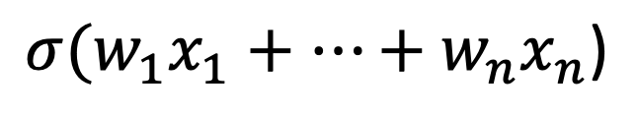
“Atom” of the ANN – artificial neuron or unit of ANN
x₁
W₁
W₂
x₂
∑
W₃
x₃
$${{σ(w}_{1}x}_{1}+…+{w_{n}x}_{n}\text{)}$$

Slide 15
ANN – stacked elementary units
∑
∑
∑
∑
∑

Slide 16
Why stacking neurons?
large house + good neuborhood + new building
house area
∑
large house + good neuborhood + new building
large house + old neuborhood + old building
neuborhood
∑
building age
large house + old neuborhood + old building

Slide 17
ANN – stacked elementary units
hidden lyaer
model
output lyaer
ŷ
input layer
or
features
output

Slide 18
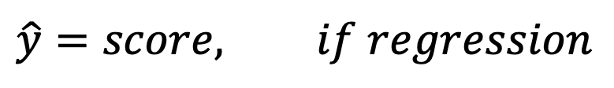
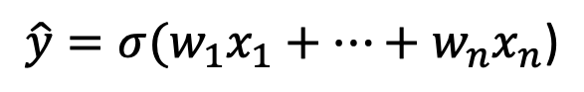
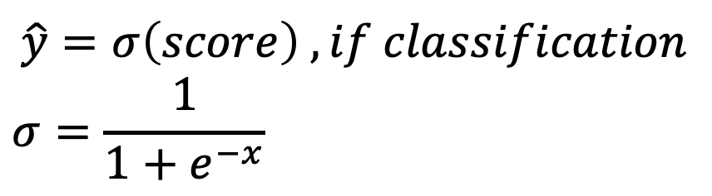
Activation functions
$${{\hat{y}=σ(w}_{1}x}_{1}+…+{w_{n}x}_{n}\text{)}$$
x₁
W₁
$$\hat{y}=score, if regression$$
W₂
x₂
∑
score
$$\hat{y}=σ\left(score\right) ,if classification$$
$$σ=\frac{1}{1+e^{−x}}$$
W₃
x₃

Slide 19
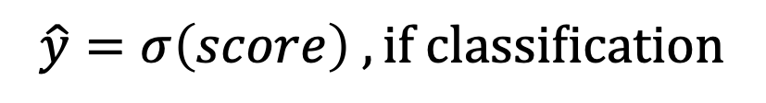
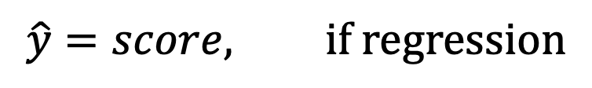
Activation functions
hidden neurons with non-linear function (usually ReLU)
$$\hat{y}=score, if regression$$
score
$$\hat{y}=σ\left(score\right) ,if classification$$

Slide 20
ANN PLAYGROUND

Slide 21
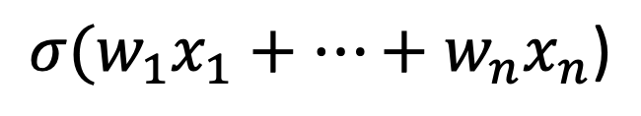
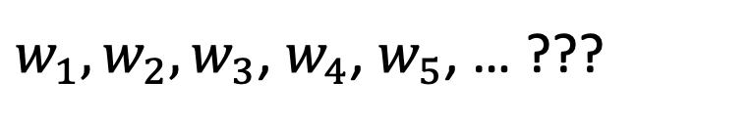
How to find good model parameters?
n.o. parameters = 3*5 + 5*1
$w_{1},w_{2},w_{3}$, $w_{4}$, $w_{5}$, … ???
$${{σ(w}_{1}x}_{1}+…+{w_{n}x}_{n}\text{)}$$

Slide 22
Gradient Descent Algorithm
prediction
”true” value
ŷ
y
Loss/Cost function
Forward pass

Slide 23


Gradient Descent Algorithm
prediction
”true” value
ŷ
y
Loss/Cost function
Small error/ loss
Large error/ loss
prediction error
Backward pass

Slide 24
Gradient Descent Algorithm
1. Forward pass
3. Backward pass
4. Update weights
2. Compute loss
ŷ

Slide 25
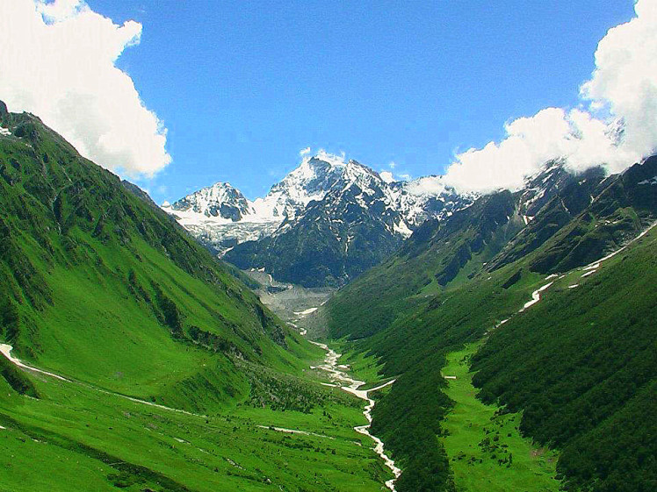

Loss landscape hiker
Here the Loss is large
Here the Loss is small
optimal path
Loss
weight 2
weight 1

Slide 26
Gradient Descent Algorithm
Most important hyper-parameters to set:
Learning rate (step size) – by what amount we adjust/ tune/ update model’s parameters (weights)

Slide 27
Learning rate
Large step size
Small step size

Slide 28
Gradient Descent Algorithm
Most important hyper-parameters to set:
Learning rate (step size) – by what amount we adjust/ tune/ update model’s parameters (weights)
Number of itearations (epochs) - how many times we update model’s weight

Slide 29
Number of itearations (epochs)
N.o. epochs is large
N.o. epochs is smal
Descended to a ”small loss region”
Did not reach a ”small loss region”

Slide 30
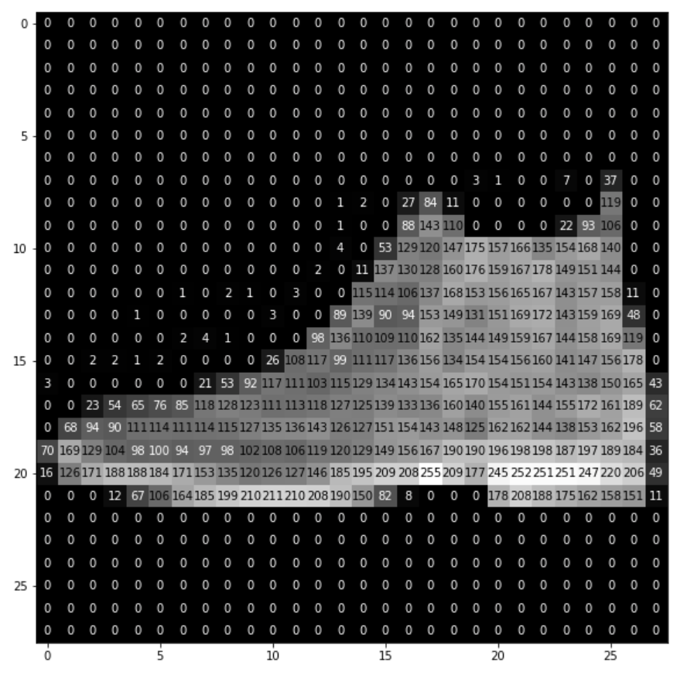
Hands on: shallow ANN for classification
Boot

Slide 31





Tools
Here we keep our code
Python libraries:
graphs
operations with arrays/ matrices
Here we run a code
deep learning

Slide 32
Data
Data point: 28x28 grayscale image of shopping item
Features: 28x28=784 pixel values (range 0-255)
Labels: Product category (boot, shirt, hat, …). 10 classes in total.

Slide 33
Typical Workflow
Data preprossing (scale 0-1), splitting (training/validation/test).
Define ANN model
Choose Loss function, Optimizer
Train ANN
Evaluate on unseen (test) dataset

Slide 34
Data preprossing
Scaling features to 0-1: makes it easier for algoritm to find “good” model parameters
Splitting (training/validation/test datasets):
Training – to find “good” model parameters
Validation – to choose model hyper-parameters (learning rate, n.o. epochs)
Test – final performance evaluation

Slide 35
Define ANN model
model = keras.Sequential([
layers.Dense(units=5, activation='relu',input_shape=(3,)),
layers.Dense(units= 1, activation='sigmoid')
])
units=5
input_shape=(3,)
units=1

Slide 36
Choose Loss function, Optimizer
Variation of basic Gradient Descent Algorithm
model.compile(optimizer='RMSprop',
loss='sparse_categorical_crossentropy',
metrics=['sparse_categorical_accuracy'])
Compare predictions and labels
Easy to understand performance measure

Slide 37
Train ANN
Features and labels
Training data = 80%
Validation = 20%
history = model.fit(X_trainval,
y_trainval,
validation_split=0.2,
batch_size=32,
epochs=20,
verbose=1)
Feed data by batches of 32
Printing info during training

Slide 38
Evaluate on test dataset
test_loss, test_accuracy = model.evaluate(X_test, y_test, verbose=0)
print('Accuracy on test dataset:', test_accuracy)

